Slide 1

Coffee Beans Sales Project
A MySQL Project
- by Abhishek Biswas

Slide 2
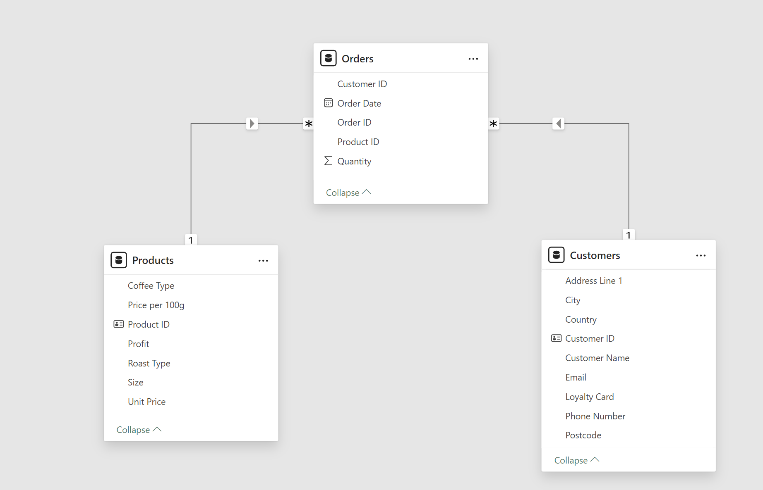
Database Schema

Slide 3
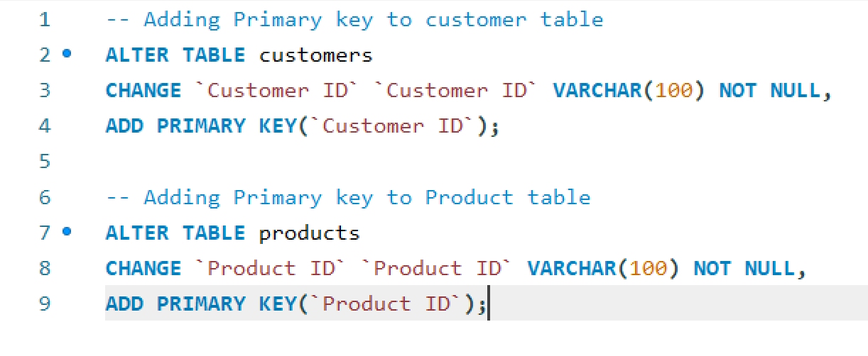
Primary key insertion

Slide 4
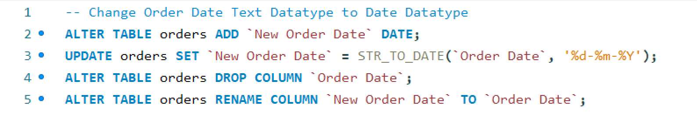
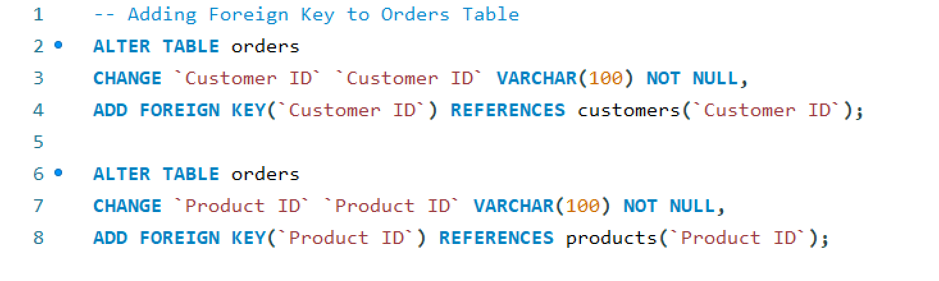
Change Orders Schema

Slide 5
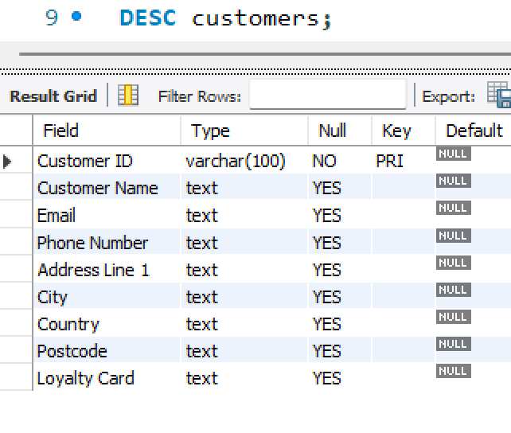
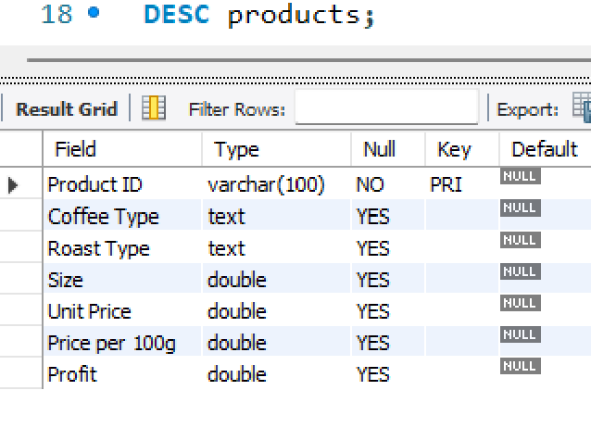
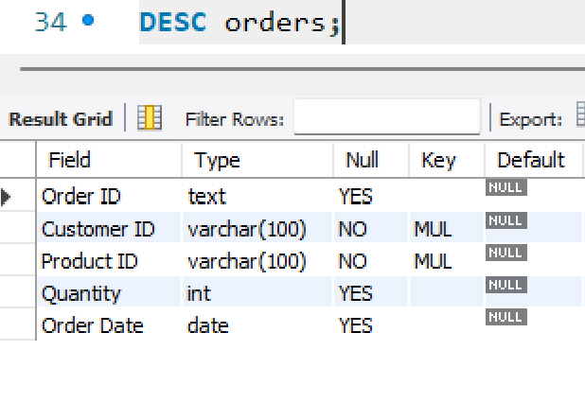
Table Schemas
INSIGHT
There are total 48 products
INSIGHT
There are total 1000 customers
INSIGHT
There are total 1000 orders

Slide 6

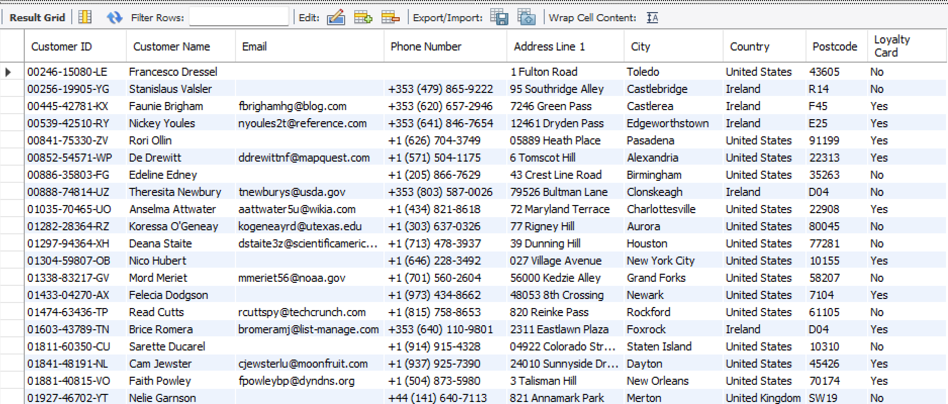
Customer Table

Slide 7
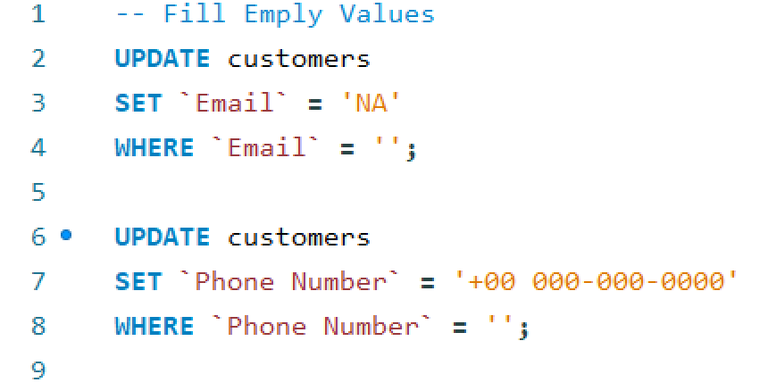
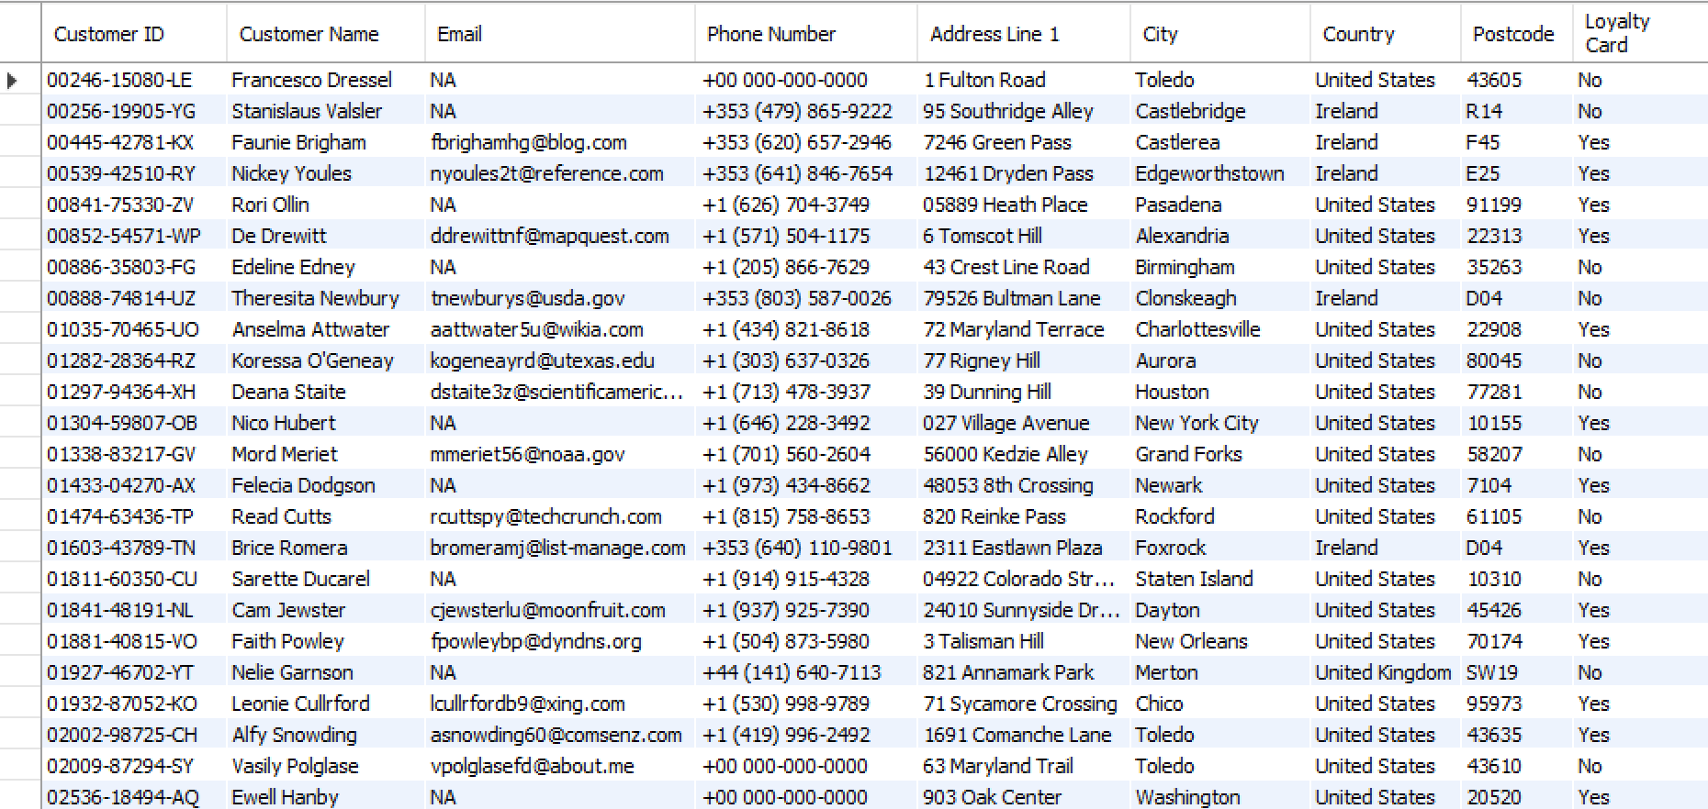
Fill empty values in customer table

Slide 8
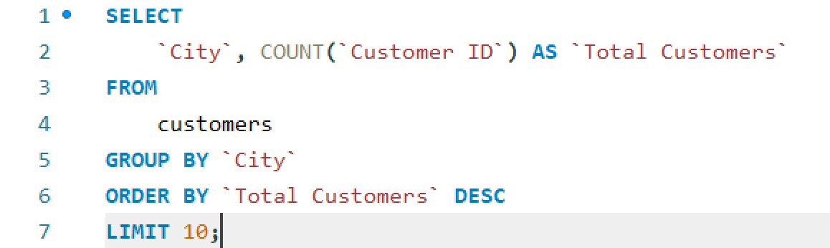
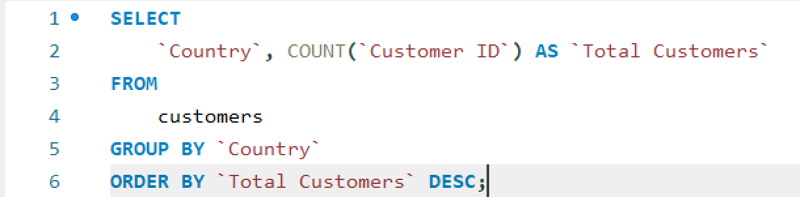
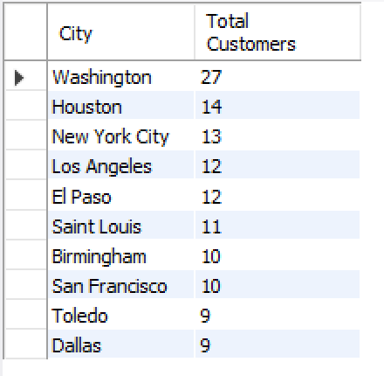
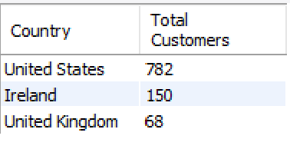
Total customers based on city and Country
Analysis
2.7% of the total customers are from “Washington City”
78.2% of the total customers are from “United States”

Slide 9
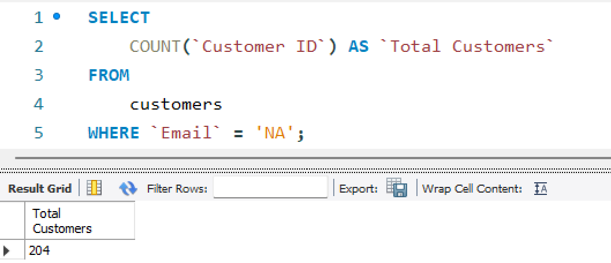
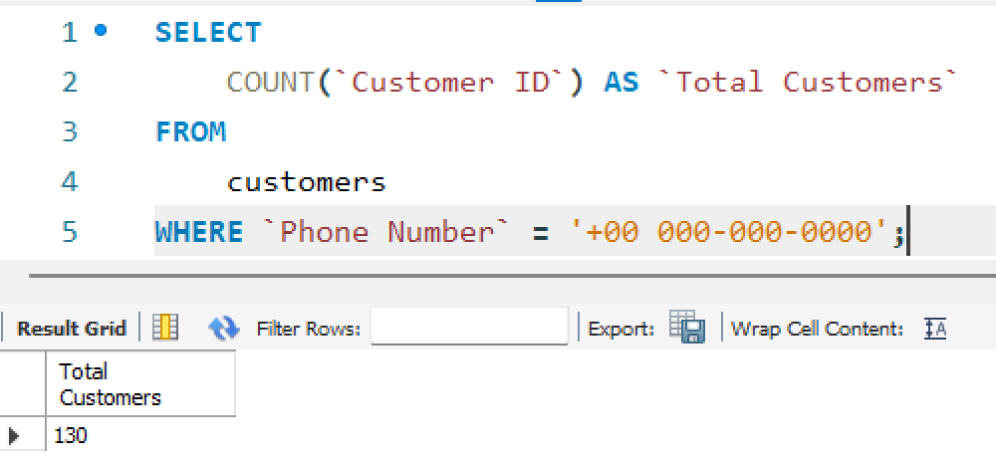
Customers without email and phone no.
Analysis
20.4% of the customers are without email Id of total customers
Analysis
Customers without phone number consist of 13% of total customers.

Slide 10
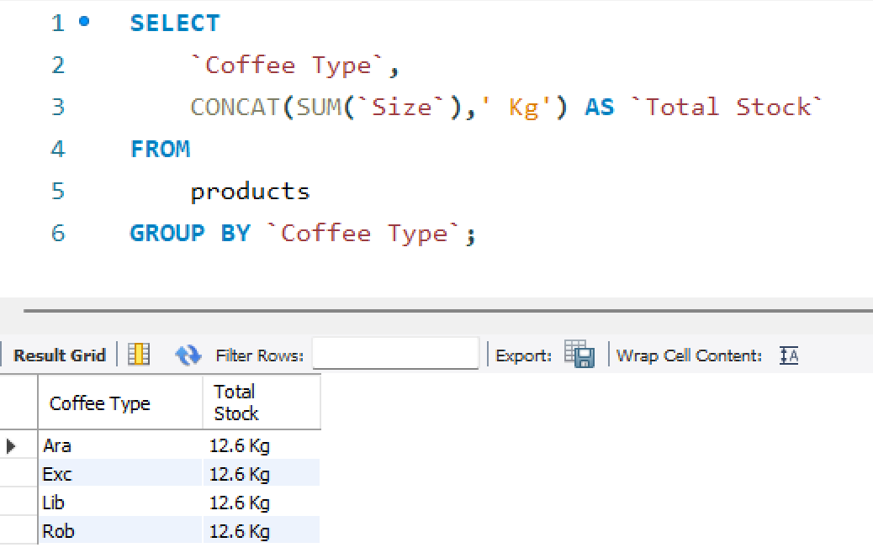
Total Stock of every Coffee Type
INSIGHT
Full form of coffee types:
Ara – Arabic (Coffee Arabica)
Exc – Excelsa (Coffee Excelsa)
Lib – Liberica (Coffee Liberica)
Rob – Robusta (Coffee Canephora)

Slide 11
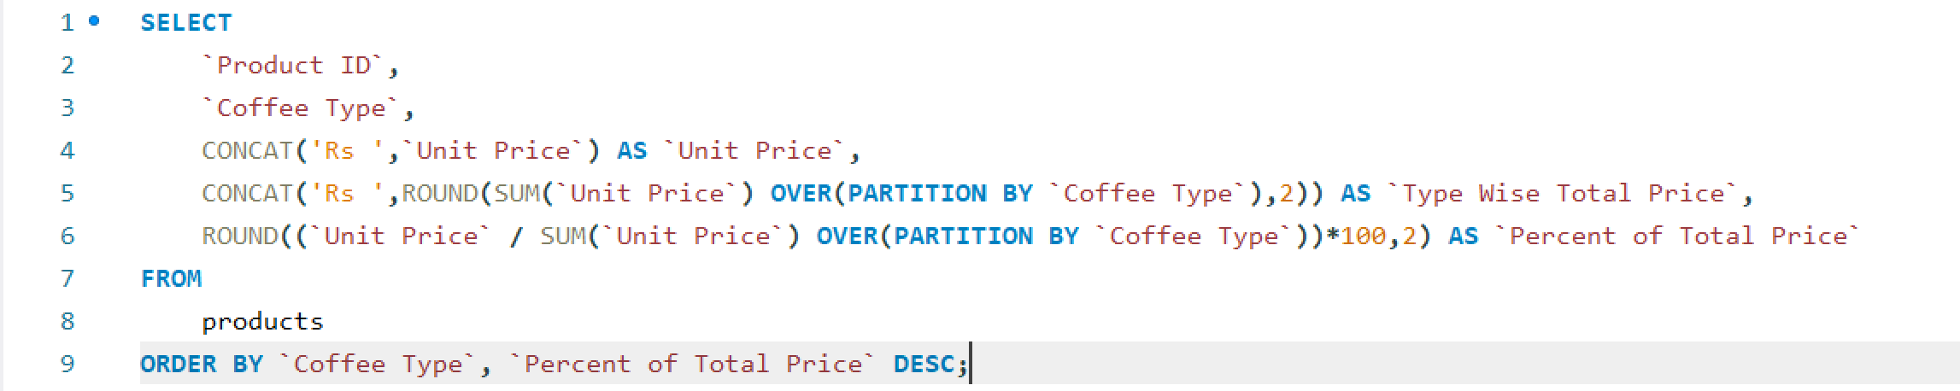
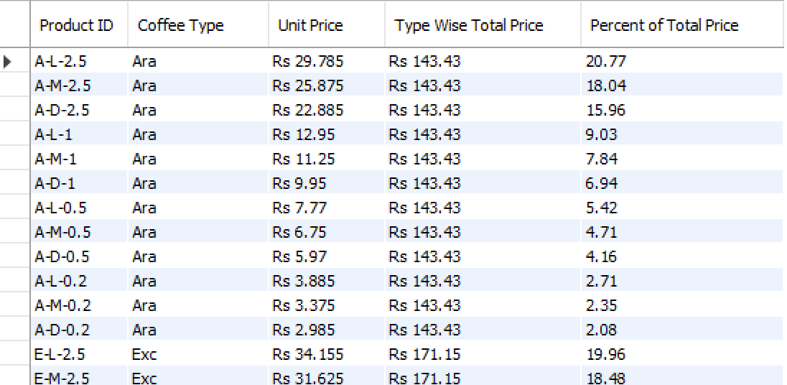
Coffee Price Breakdown by Type with Percent Contribution

Slide 12
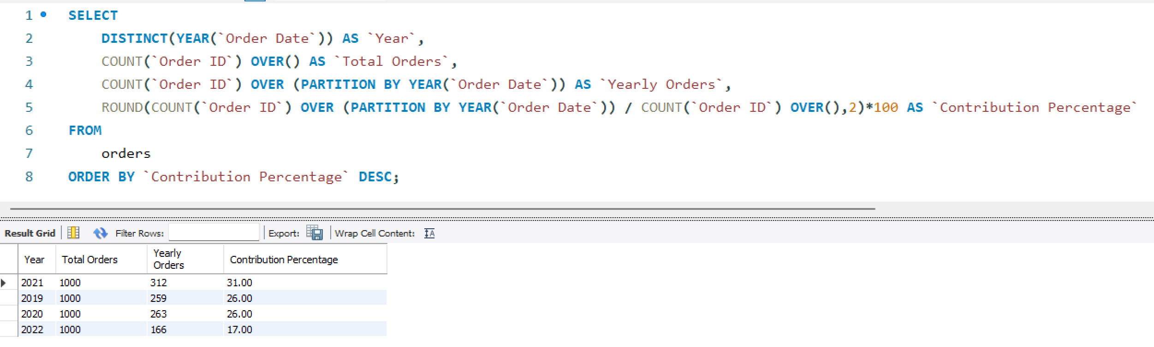
Yearly Order Distribution with Total Orders and Contribution Percentage

Slide 13
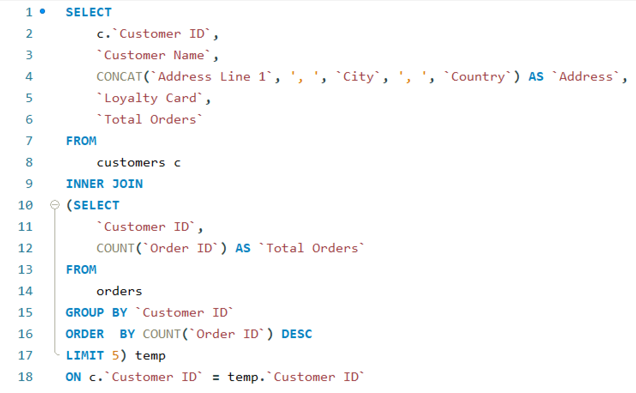
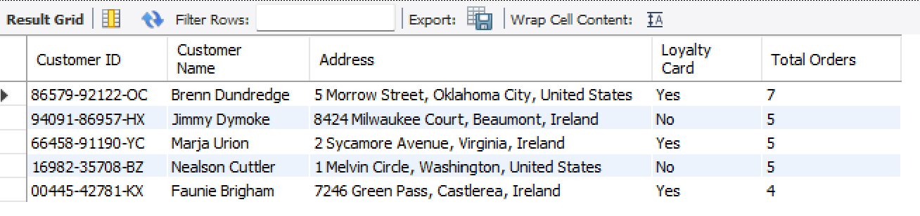
Top 5 Most Active Customers with Contact Details

Slide 14
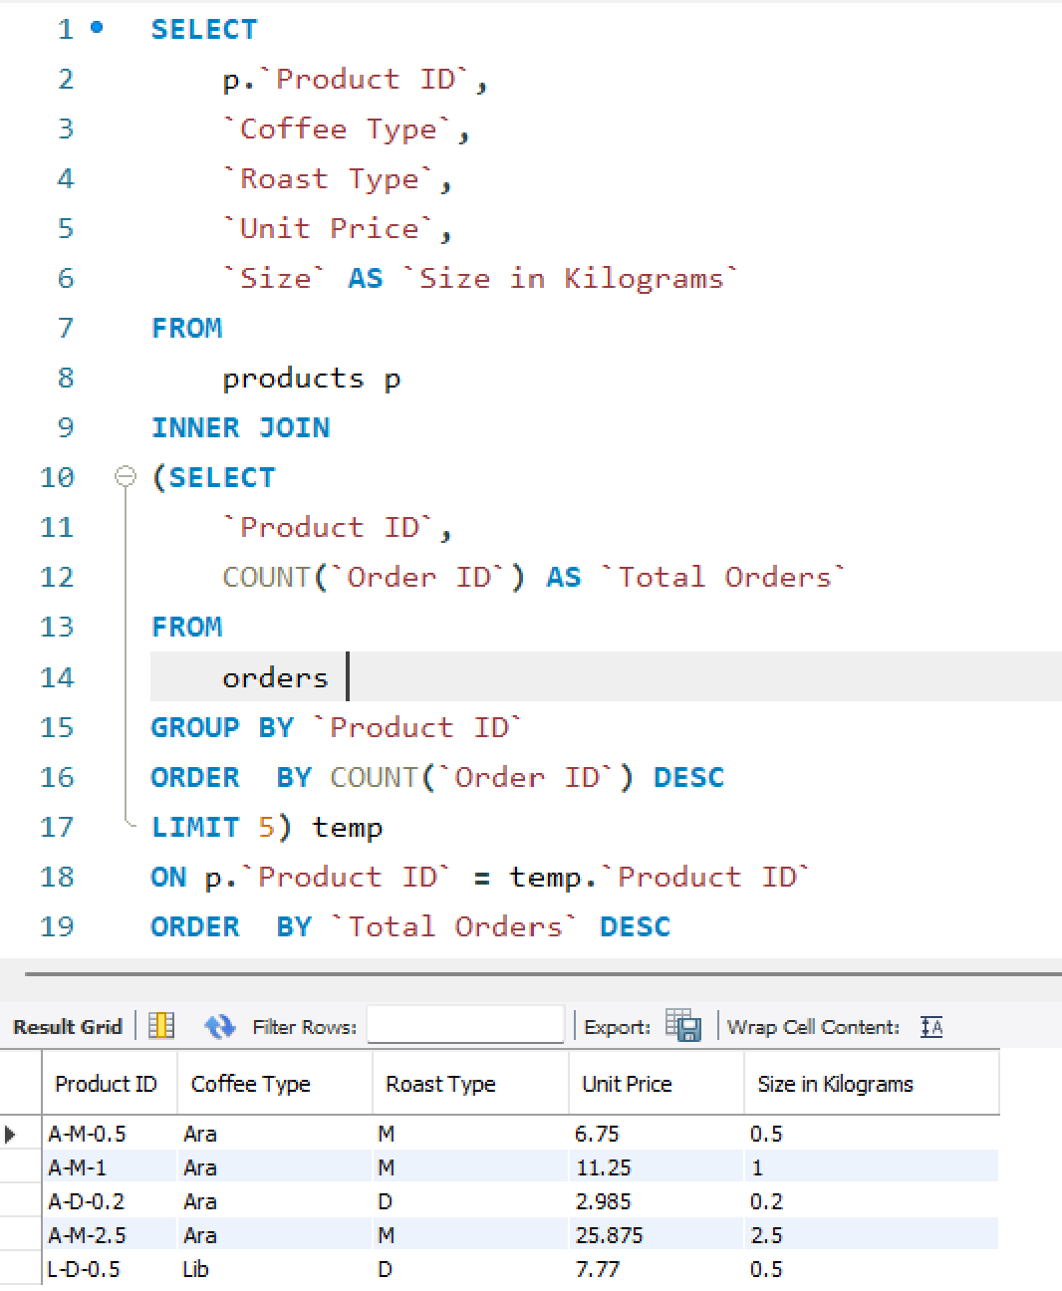
Top 5 Frequently ordered products with Details and Size

Slide 15
Coffee Beans Sales Project
Thank You

